Slide 1

Automated Data Collection & AI-Driven Synthesis
Bachelors Thesis Preparation - Current Stage Report
Accuracy in cinematographic data retrieval
By Muntean Daniel
Coord. Dr. Monica Sancira

Slide 2

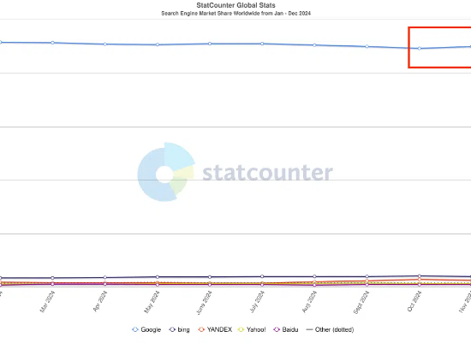
THE PARADIGM SHIFT IN SEARCH
<90%
Search Engine Market Share (Late 2024)
80%
Consumers Relying on AI Summaries

Slide 3
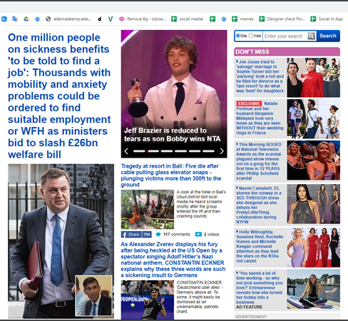
FRICTION IN MODERN WEB NAVIGATION
Fragmented User Experience
Aggressive advertising real estate cluttering UI.
Restrictive paywalls blocking immediate access.
Manipulated content obscuring targeted data.
Users migrating toward frictionless AI agents.

Slide 4





VULNERABILITIES: AI HALLUCINATIONS
Pre-training Noise
Knowledge Gaps
Prompt Erraticism
Models internalize noise and conflicting info from massive, unfiltered internet data sets.
Static internal memory post-training leads to fabrication when queried on specialized domains.
Prioritizing conversational flow or formatting over factual fidelity in complex instructions.

Slide 5
MOTIVATION FOR HYBRID SOLUTIONS
Siloed Platforms: Relevant data is distributed across heterogeneous sources with inconsistent formats.
Efficiency Gap: Real value depends on how efficiently data is integrated and interpreted.
The Accuracy Mandate: Need for architectures that separate the LLM processing engine from the knowledge base.
Unified Automation: Converting raw metadata into consistent, digestible, and accurate output formats.

Slide 6
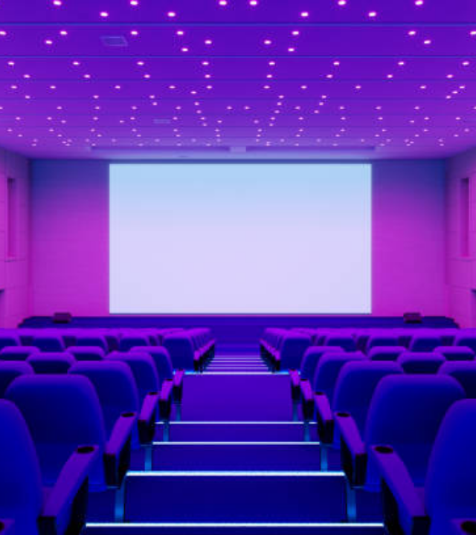
THE PROPOSED SOLUTION: MOVIE ANALYZER
Architectural Grounding
A web-based application designed to bridge the gap between distributed cinematographic data and AI interpretation.
By enforcing a platform-specific constraint, the system restricts the AI's "world knowledge" to the specific metadata retrieved from external datasets, eliminating generic interpolations.

Slide 7
METHODOLOGICAL PIPELINE
1. Data Retrieval
2. Preprocessing
3. Reasoning
4. Presentation
Kaggle API queries for IMDb dataset (Latest titles).
Filtering results based on user search and metadata extraction.
Gemini API analysis using targeted predefined templates.
Structured HTML output for user-friendly UI integration.

Slide 8
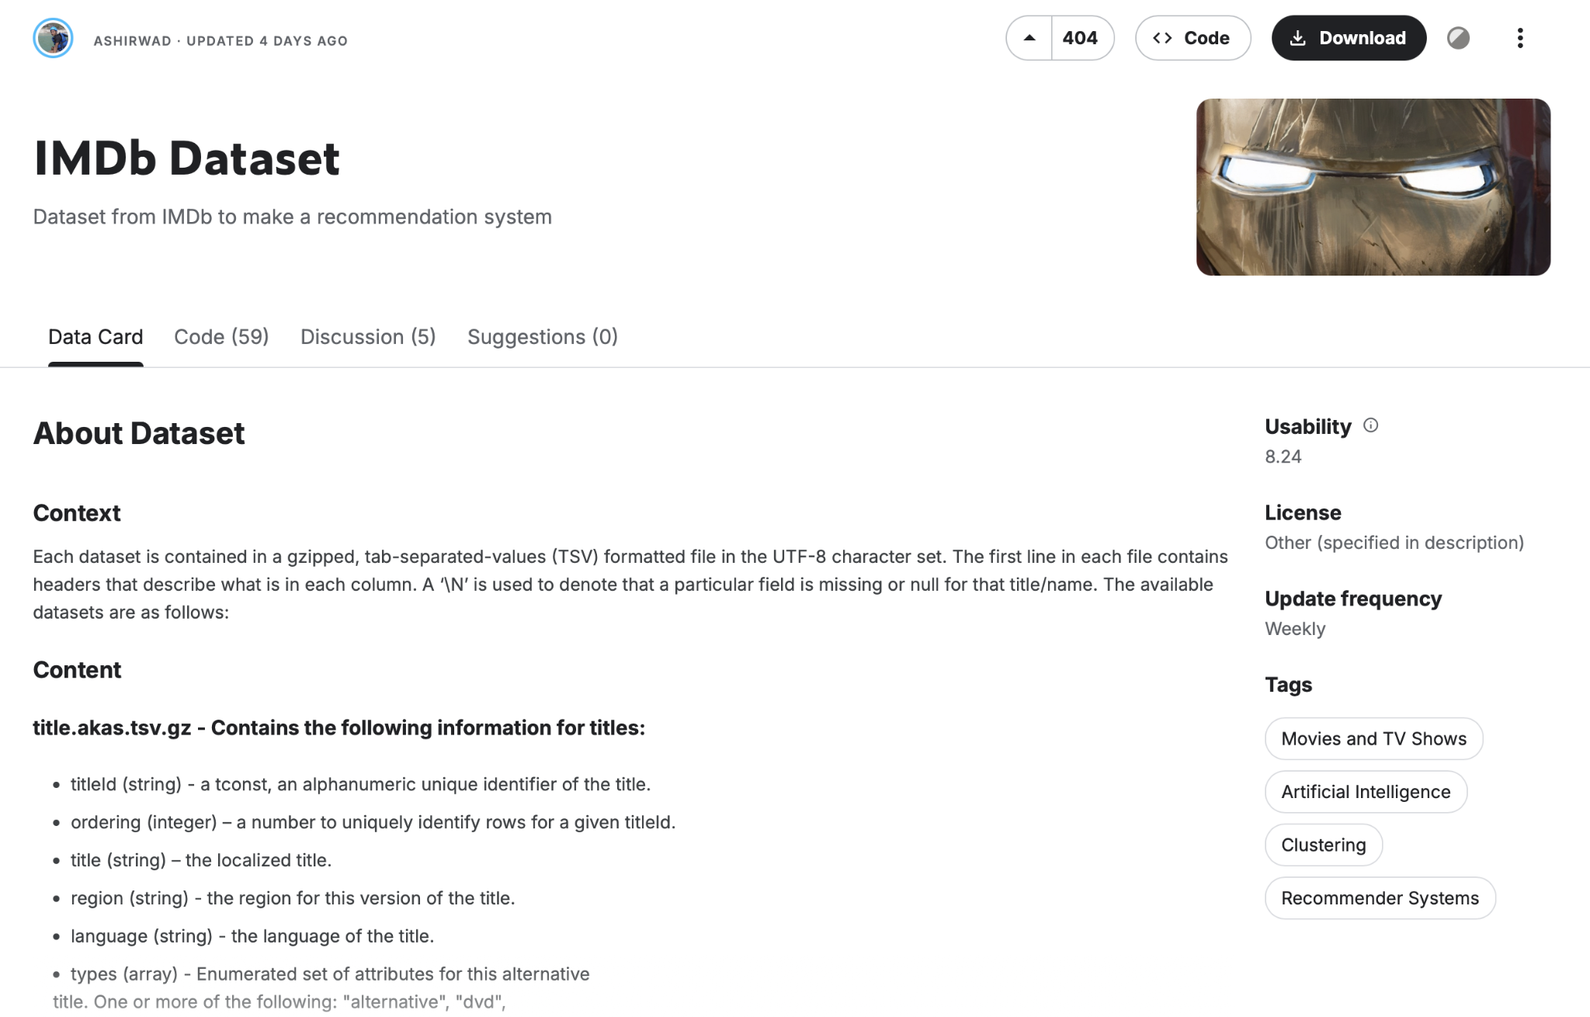
ACQUISITION & PREPROCESSING
Leveraging Kaggle API
The system utilizes the Kaggle API to access a comprehensive, regularly updated IMDb dataset. This ensures data freshness and reliability.
Initial query matching titles and release years.
Trimming metadata to only relevant "grounded" fields.
Selection of analysis selection left to the user.

Slide 9


SEMANTIC ANALYSIS WITH GEMINI
The Reasoning Engine
Forcing Context
Integration of Gemini API as an interpretation layer. Unlike generic chatbots, the application uses a targeted predefined template that wraps raw metadata.
By providing the exact data required, the model is constrained to the provided context. This inhibits "wandering neural pathways" and enforces factual fidelity.

Slide 10
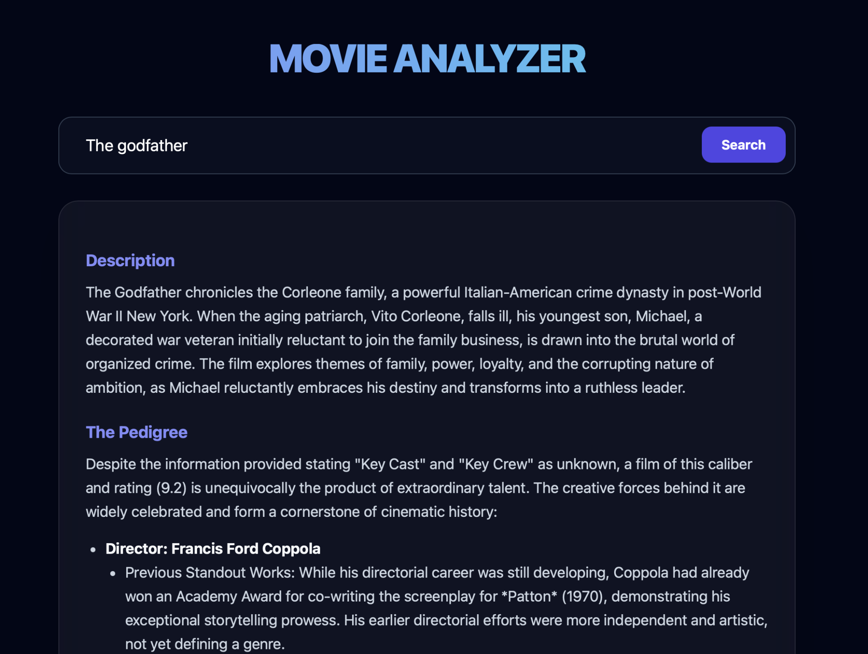
USER INTERFACE INTEGRATION
From Metadata to Verdict
The LLM is instructed to output results using a restricted set of HTML tags. This enables immediate front-end rendering without complex parsing.
Narrative Summarization
Pedigree Evaluation (Cast/Crew)
Style Recommendations
Final "Worth Watching" Verdict

Slide 11
MITIGATING HALLUCINATIONS
Hallucination Source | General LLM Risk | Proposed Solution (Movie Analyzer)
Knowledge Boundary | Interpolates missing facts. | Dataset Grounding: Restricted to IMDb metadata.
Domain Metadata | Fabricates obscure details. | Pre-conditioned Prompts: Specific data injection.
Logic Errors | Focuses on conversational flow. | Output Serialization: Restricted HTML tags.

Slide 12
Questions?
Current Status: Prototype Pipeline Completed
Next Step: Empirical Evaluation of Synthesis Accuracy

